Slide 1
SQA BootCamp
Over-View of Software Standards & Requirements

Slide 2
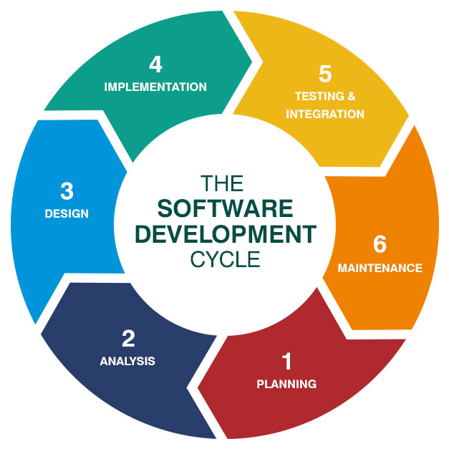
SDLC & Software Process
SDLC is a structured process that defines the steps involved in developing, delivering, and maintaining a software product.
Typical SDLC Phases:
Requirement Gathering & Analysis
System Design
Implementation (Coding)
Testing
Deployment
Maintenance

Slide 3
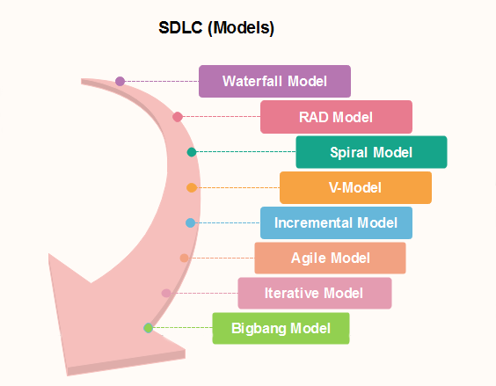
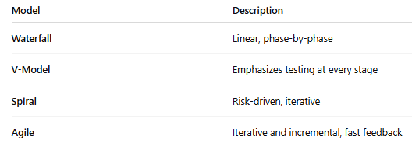
Software Process Model
A software process is a set of related activities that lead to the production of a software product.
These models influence how requirements are managed, how traceability is implemented, and when testing starts.

Slide 4
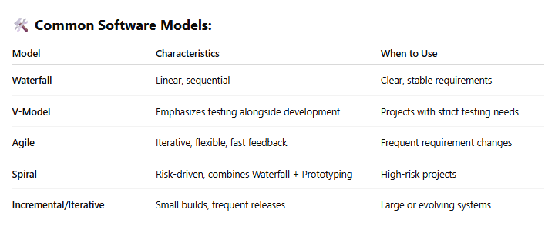
Software Process Models?
A software process model is a framework that defines the order, flow, and relationship of development activities throughout the SDLC.

Slide 5
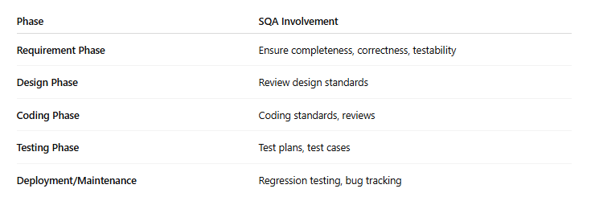
Role of SQA in the SDLC
SQA is not just testing — it's a mindset and activity that begins from the requirement phase.

Slide 6
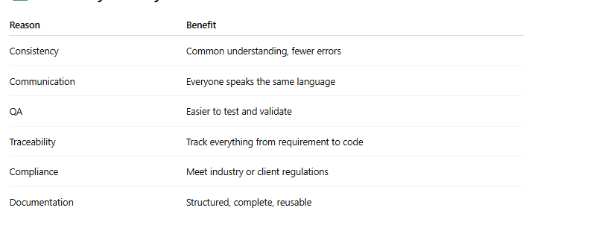
Software Standards
A software standard is an agreed-upon set of rules, guidelines, or specifications that define best practices for software development and quality assurance.

Slide 7
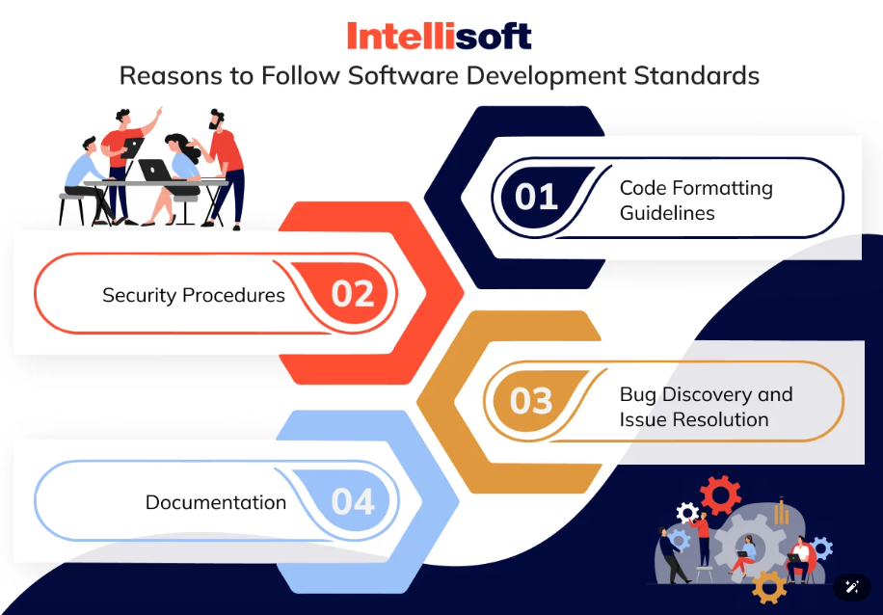
Standards and Models
We have studied earlier SDLC Models . Let’s learn about standards.
Why we follow Standards
To ensure quality from the very beginning.
Consistency and Uniformity
Improved Communication
Reusability and Scalability
Quality Assurance
Testing & Traceability
Notes:
IEEE – Institute of Electrical and Electronics Engineers
IEEE is a global professional organization that develops industry standards for engineering, including software engineering.
It has a special body called the IEEE Standards Association (IEEE-SA) that creates, reviews, and maintains these standards.

Slide 8
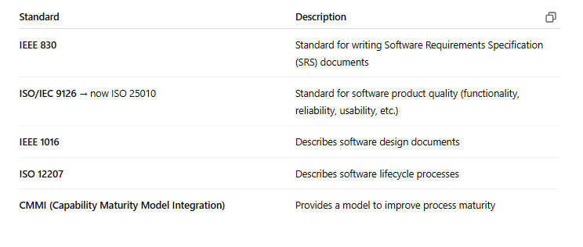
Types of Software Standards (Examples)

Slide 9
Requirement Phase
What is Software Requirement
A complete description of what the software system will do without describing how it will do it is represented by the software requirements.
Sources for Requirement
Stakeholders (People affected in some way by the system)
Documents
Existing system
Domain/business area

Slide 10
Why Important ?
The hardest single part of building a software system is deciding what to build...No other part of the work so cripples the resulting system if done wrong. No other part is difficult to rectify later
Fred Brooks
Example of Requirement
> The system shall allow users to search for an item by title, author, or by International Standard Book Number

Slide 11
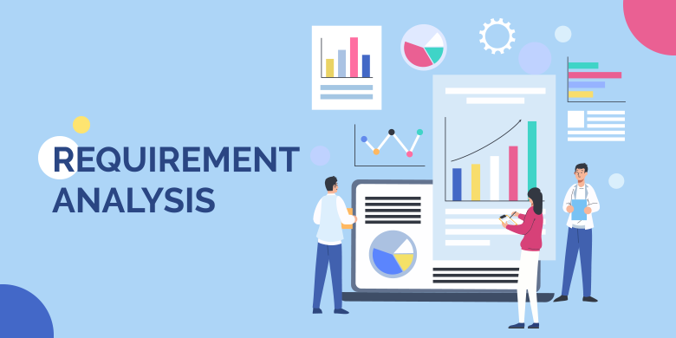
Requirement Analysis
we understand the standards we follow and the models we apply during development, let's move deeper into requirement analysis — the first and most crucial phase of the SDLC

Slide 12
Requirements Analysis & Traceability
Requirements are the foundation of any software system. If they're wrong, everything else will be wrong — design, code, test cases, even deployment.
What is Requirements Analysis?
Requirements analysis is the process of studying, understanding, and refining the requirements gathered from stakeholders.

Slide 13
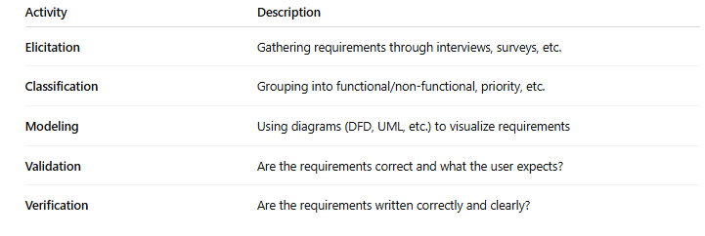
Main Goals & Activities:
Clarify what the user actually wants
Detect inconsistencies, ambiguities, and incompleteness
Convert raw stakeholder inputs into structured, testable, and traceable requirements

Slide 14
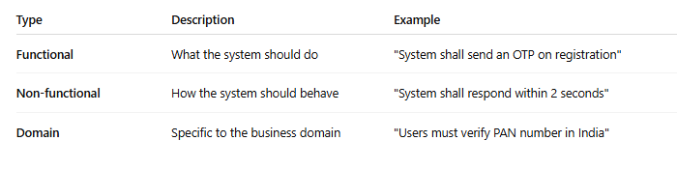
Types of Requirements:
Functional Requirements
Statements describing what the system does Functionality of the system.
Functional requirements should be complete and consistent
Non Functional Requirements
Most non-functional requirements relate to the system as a whole. They include constraints on timing, performance, reliability, security, maintainability, accuracy, the development process, standards, etc.

Slide 15
Requirements Traceability
Requirements Traceability is the ability to track each requirement throughout the project lifecycle — from its origin to implementation and testing.
Why It's Important:
Ensures nothing is missed or lost during design, coding, or testing
Useful in impact analysis when a requirement changes
Supports auditing and compliance
Helps with test coverage and defect tracking

Slide 16
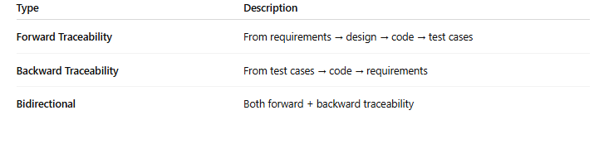
Types of Traceability:

Slide 17
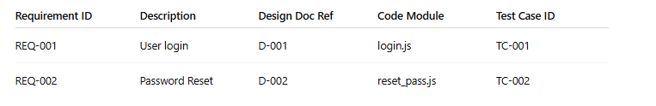
Traceability Matrix (RTM)
A simple RTM helps answer:
"Was this requirement tested?"
"Which module will break if this requirement changes?"

Slide 18
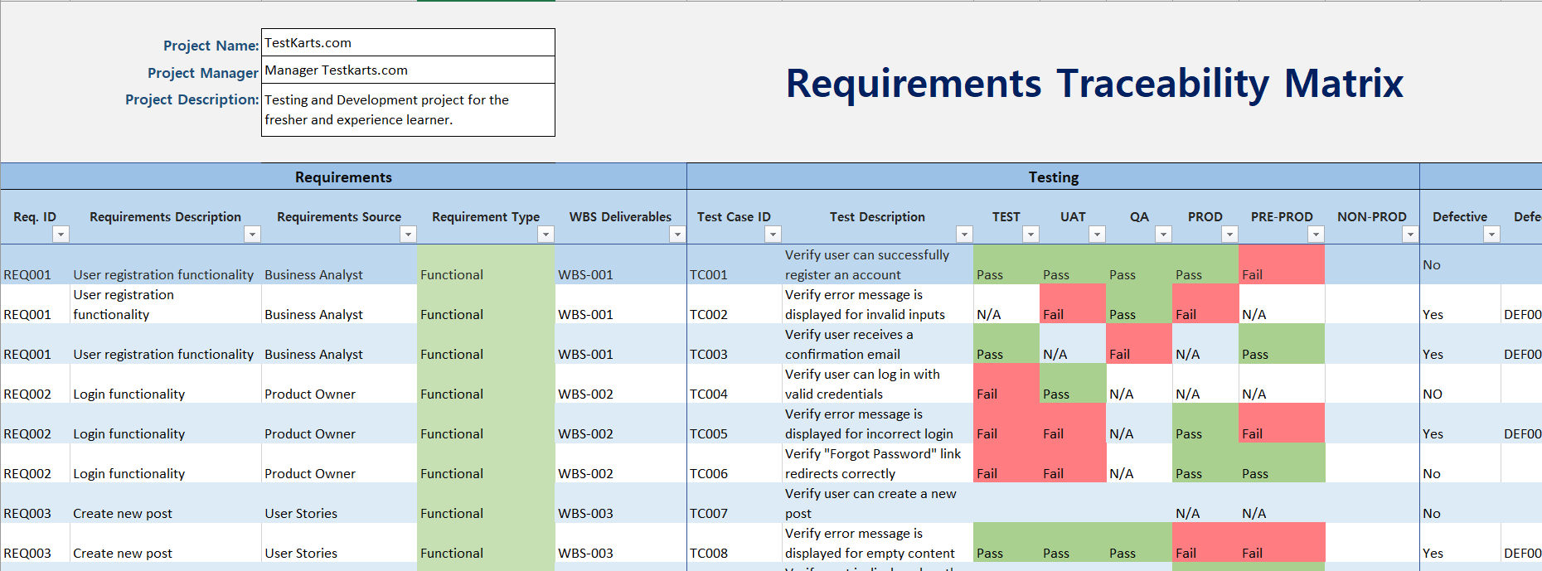
Traceability Matrix (RTM) Example

Slide 19
SRS Document Structure
Once you know how to analyze requirements, show how they are documented.
Purpose of an SRS (Software Requirements Specification)
IEEE 830 format or similar:
Introduction
Overall description
Specific requirements
Appendices
Real-world importance: used for validation, testing, and future changes
🎯 Link: Good requirements make a good SRS. Traceability is easier if SRS is clear.

Slide 20
Characteristics of Good Requirements
This reinforces what should go into the SRS and what QA teams look for.
📌 Explain with examples:
Clear
Complete
Consistent
Testable
Feasible
Traceable
🎯 Link: Good requirements ensure a quality product and help in creating good test cases later.

Slide 21
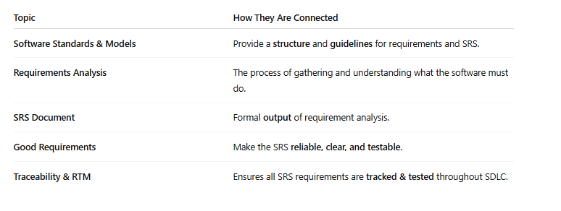
Relation Between the Topics:

Slide 22
Example Scenario: Smart Pet Feeder App
Problem Statement:
You're building a Smart Pet Feeder App – a mobile+web application that allows pet owners to remotely feed their pets using an IoT-enabled smart feeder. The feeder dispenses food on command or on a schedule, and the app sends real-time updates and alerts.
This system will:
Let users schedule feedings.
Dispense food manually.
Notify when the bowl is empty or jammed.
Track pet eating habits.
Work with different feeder hardware.

Slide 23
Applying All Concepts in This Scenario
1. ✅ Software Standards & Models
📌 In Real Projects: You follow IEEE 830 for writing the SRS and V-Model for development/testing.
Why V-Model?
Because every requirement will have a corresponding test case – easy to explain traceability.
Standards Used:
ISO/IEC/IEEE 29148 – for writing clear, complete requirements.
IEEE 830 – for documenting the SRS.

Slide 24
2. 🔍 Requirements Analysis & Traceability
📌 Stakeholders:
Pet owners (end users)
Mobile app developers
IoT engineers
Customer support
Product manager
📌 Sample Functional Requirements:
User can log in and add multiple pets.
App sends feed command to device on schedule.
Bowl status is shown on the app.
📌 Non-Functional Requirements:
App should respond in under 2 seconds.
Support at least 1,000 concurrent users.
📌 Traceability starts here: Every requirement is assigned an ID (e.g., REQ-001), and we'll later ensure it maps to SRS and test cases.

Slide 25
📄 SRS Document Structure (IEEE 830 Format)
Here’s a sample outline of the SRS for the Pet Feeder App:
📌 1. Introduction:
Purpose: Define behavior of the Smart Pet Feeder App.
Scope: Mobile/web app that controls smart pet feeders via cloud.
Definitions: Feeder = hardware device, Schedule = timed feed event, etc.
📌 2. Overall Description:
System features
User classes: Owner, Admin
Assumptions: Internet must be available.

Slide 26
📄 SRS Document Structure (IEEE 830 Format)
📌 3. Specific Requirements (Functional + Non-Functional):
REQ-001: User Login/Signup
REQ-002: Add/Edit/Delete Pet Profile
REQ-003: Schedule Feed
REQ-004: Manual Feed
REQ-005: Real-time notification on feeder status

Slide 27
🌟 Characteristics of Good Requirements
Let’s pick one requirement and evaluate it:
Bad: "System should feed the pet when needed."
Improved (Good Requirement):
"The system shall allow the user to schedule food dispensing at specific times with 1-minute granularity via the mobile app."
✅ Characteristics:
Clear
Testable
Unambiguous
Feasible
📌 Tip: Show 2–3 examples and ask the audience to identify what’s wrong/good.

Slide 28
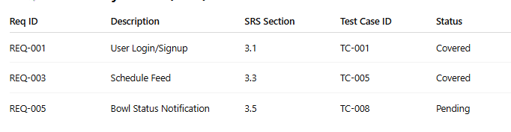
Traceability Matrix (RTM)
You’ll use this to track which requirements are implemented and tested.
Helps QA teams verify that no requirement is missed.

Slide 29
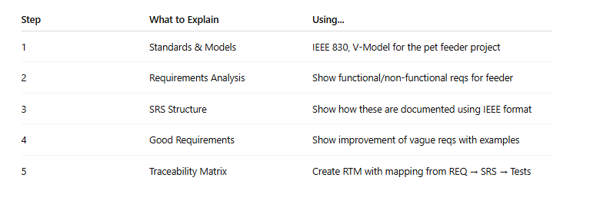
Final Flow Summary for Lecture

Slide 30
Any Question ?
Feel Free to Share your thoughts & Feedback

